Slide 1
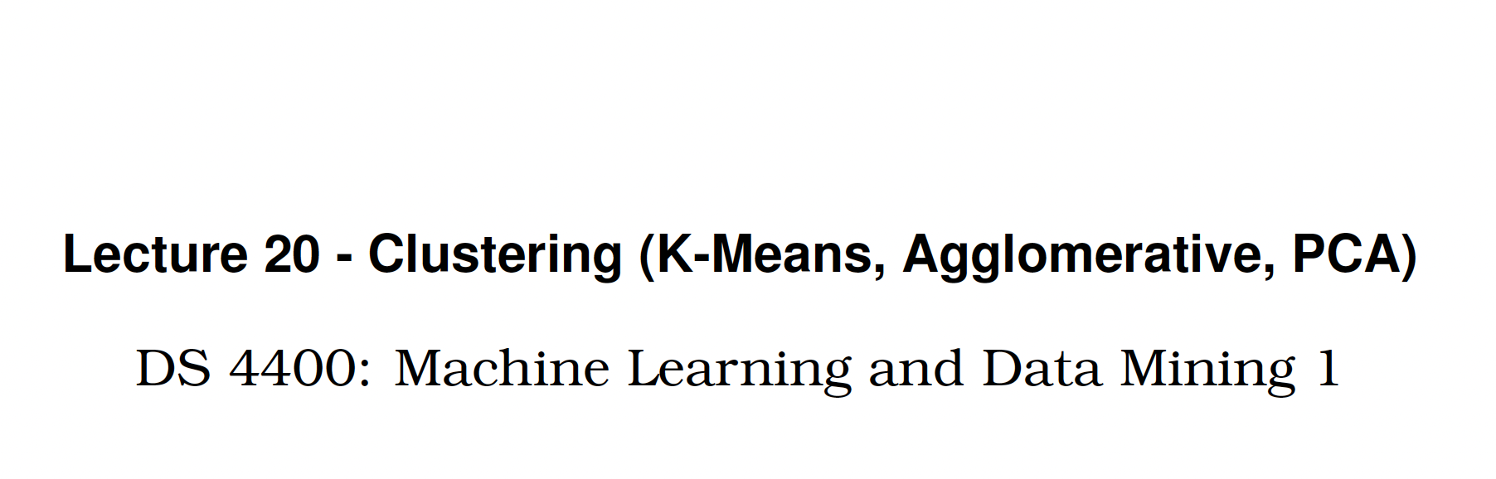

Slide 2
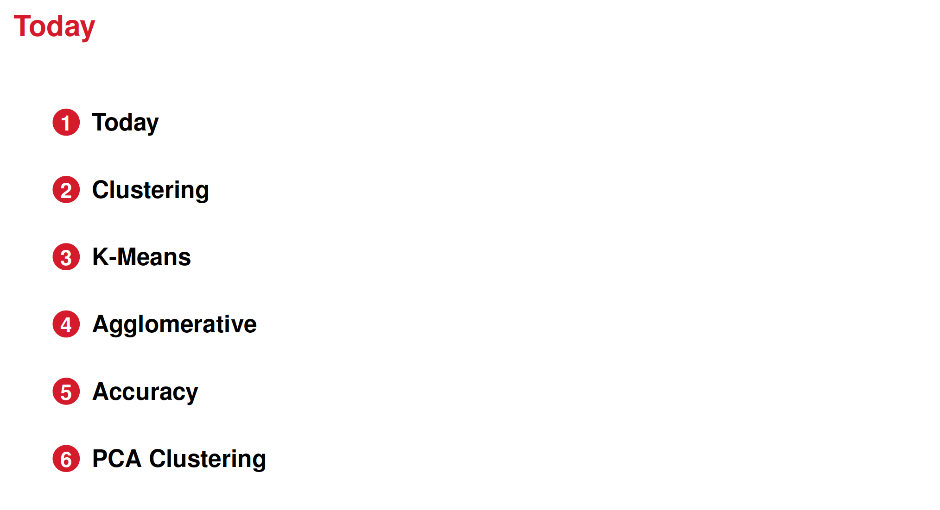

Slide 3
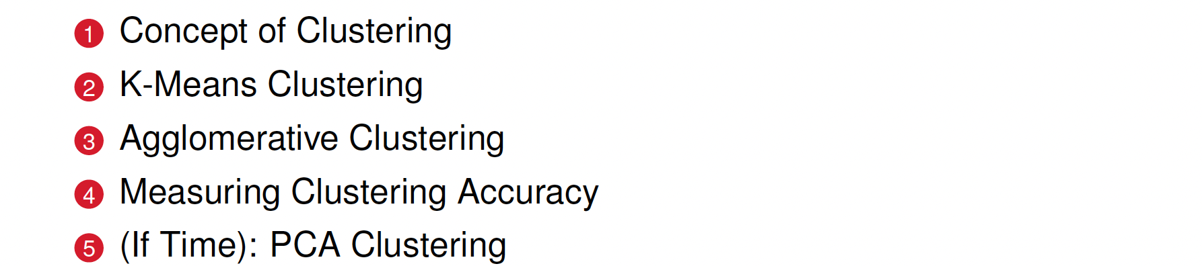

Slide 4
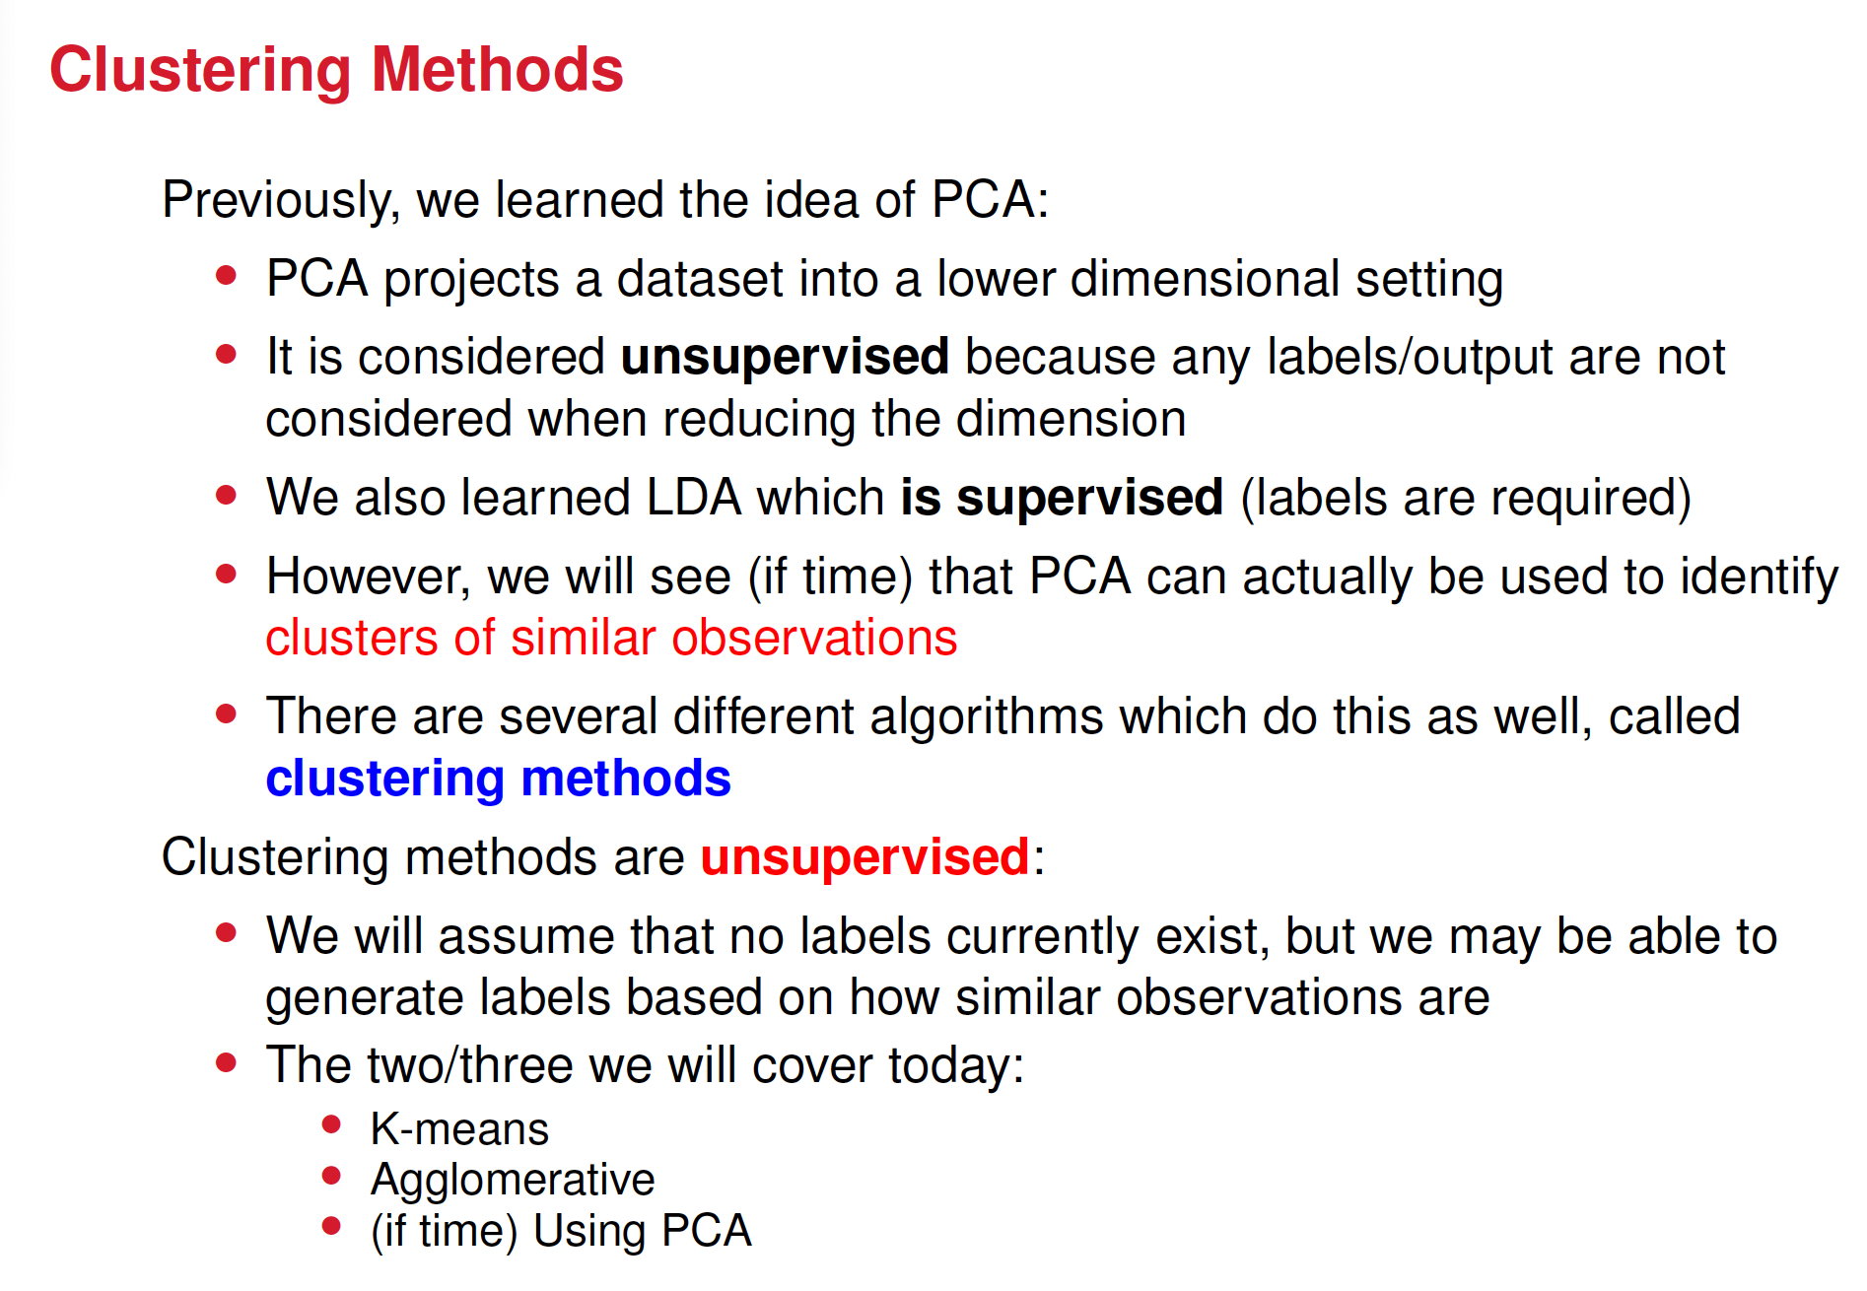

Slide 5
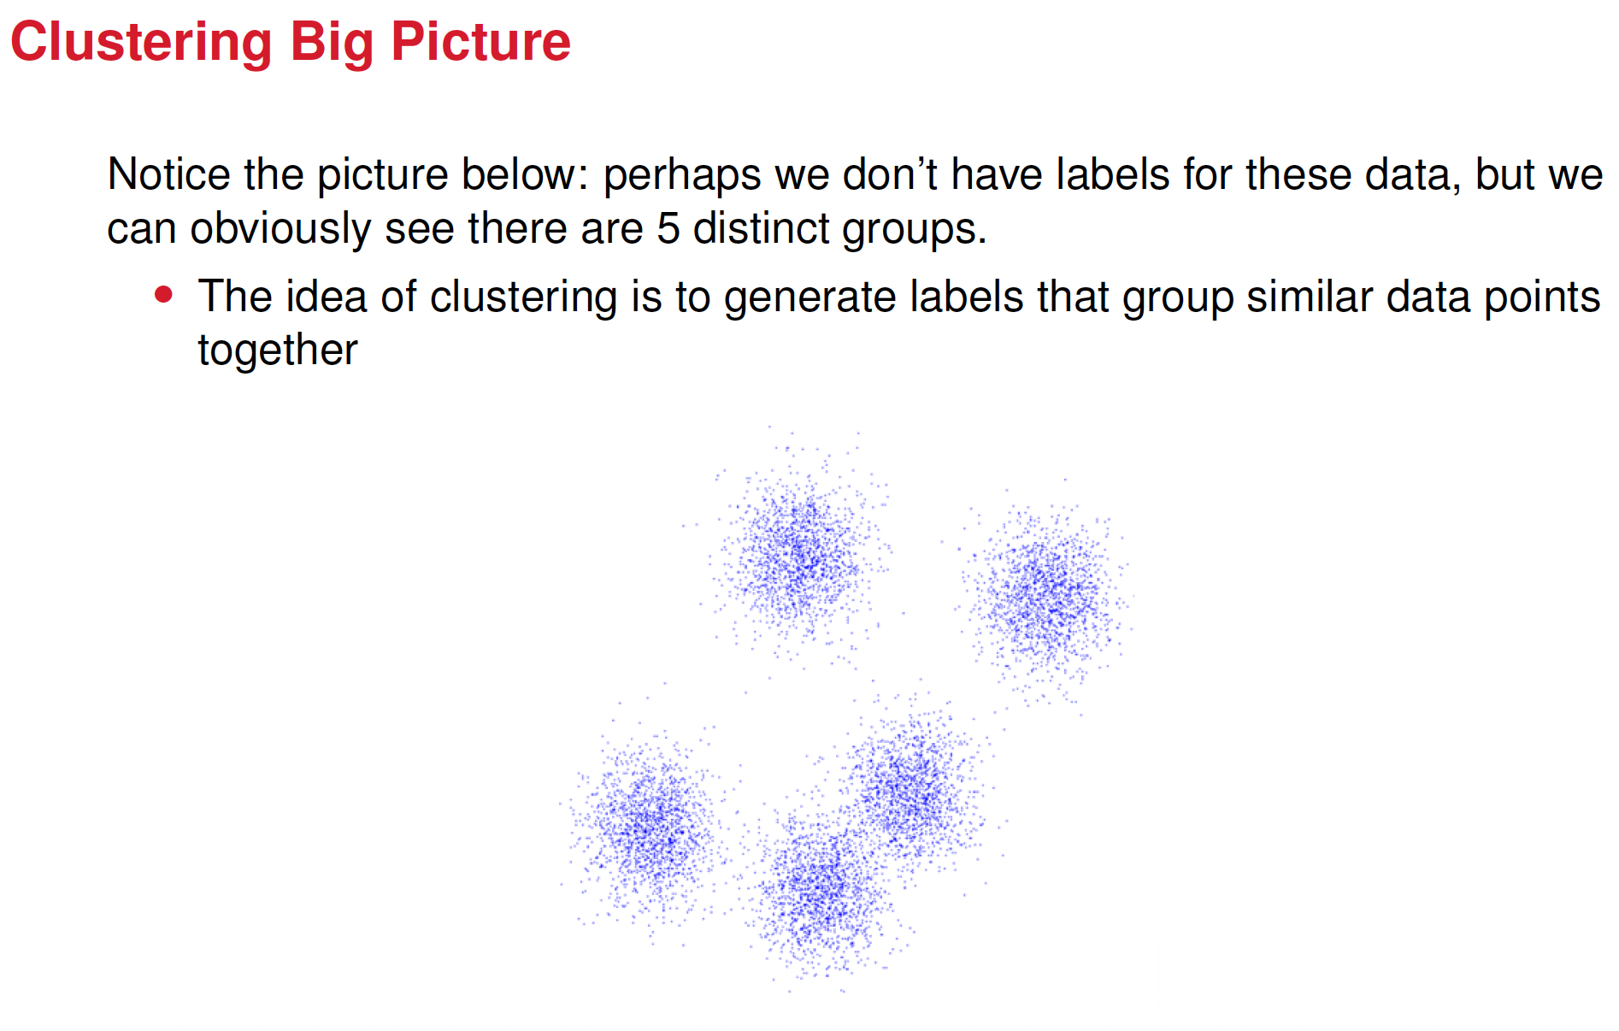

Slide 6
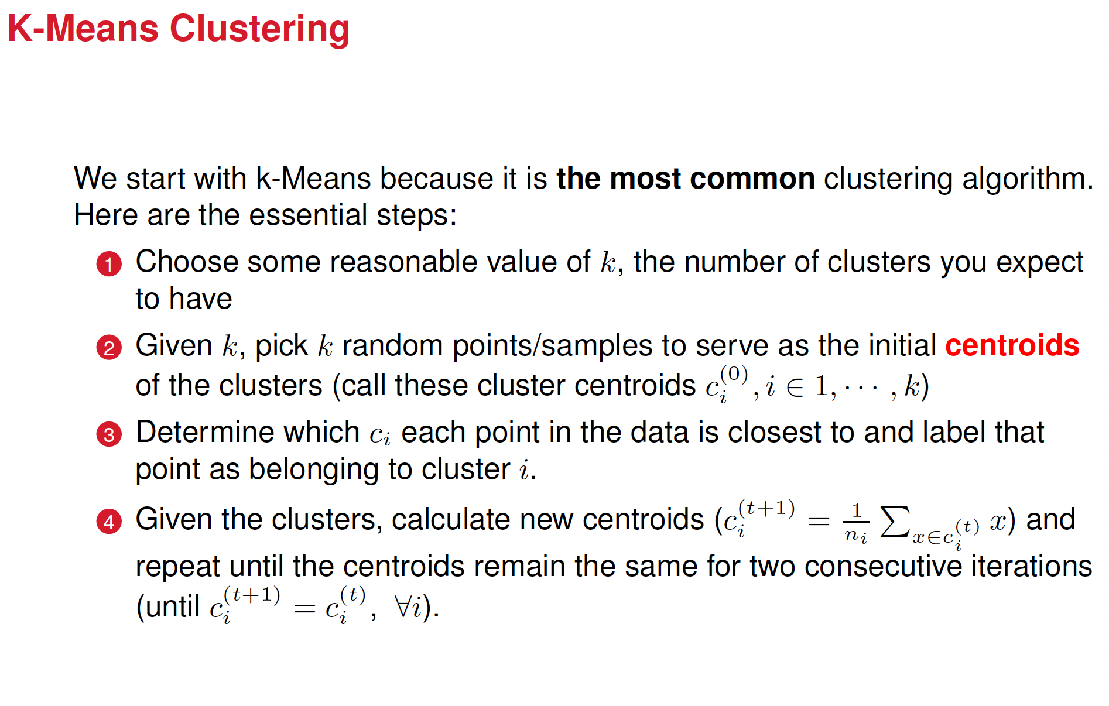

Slide 7
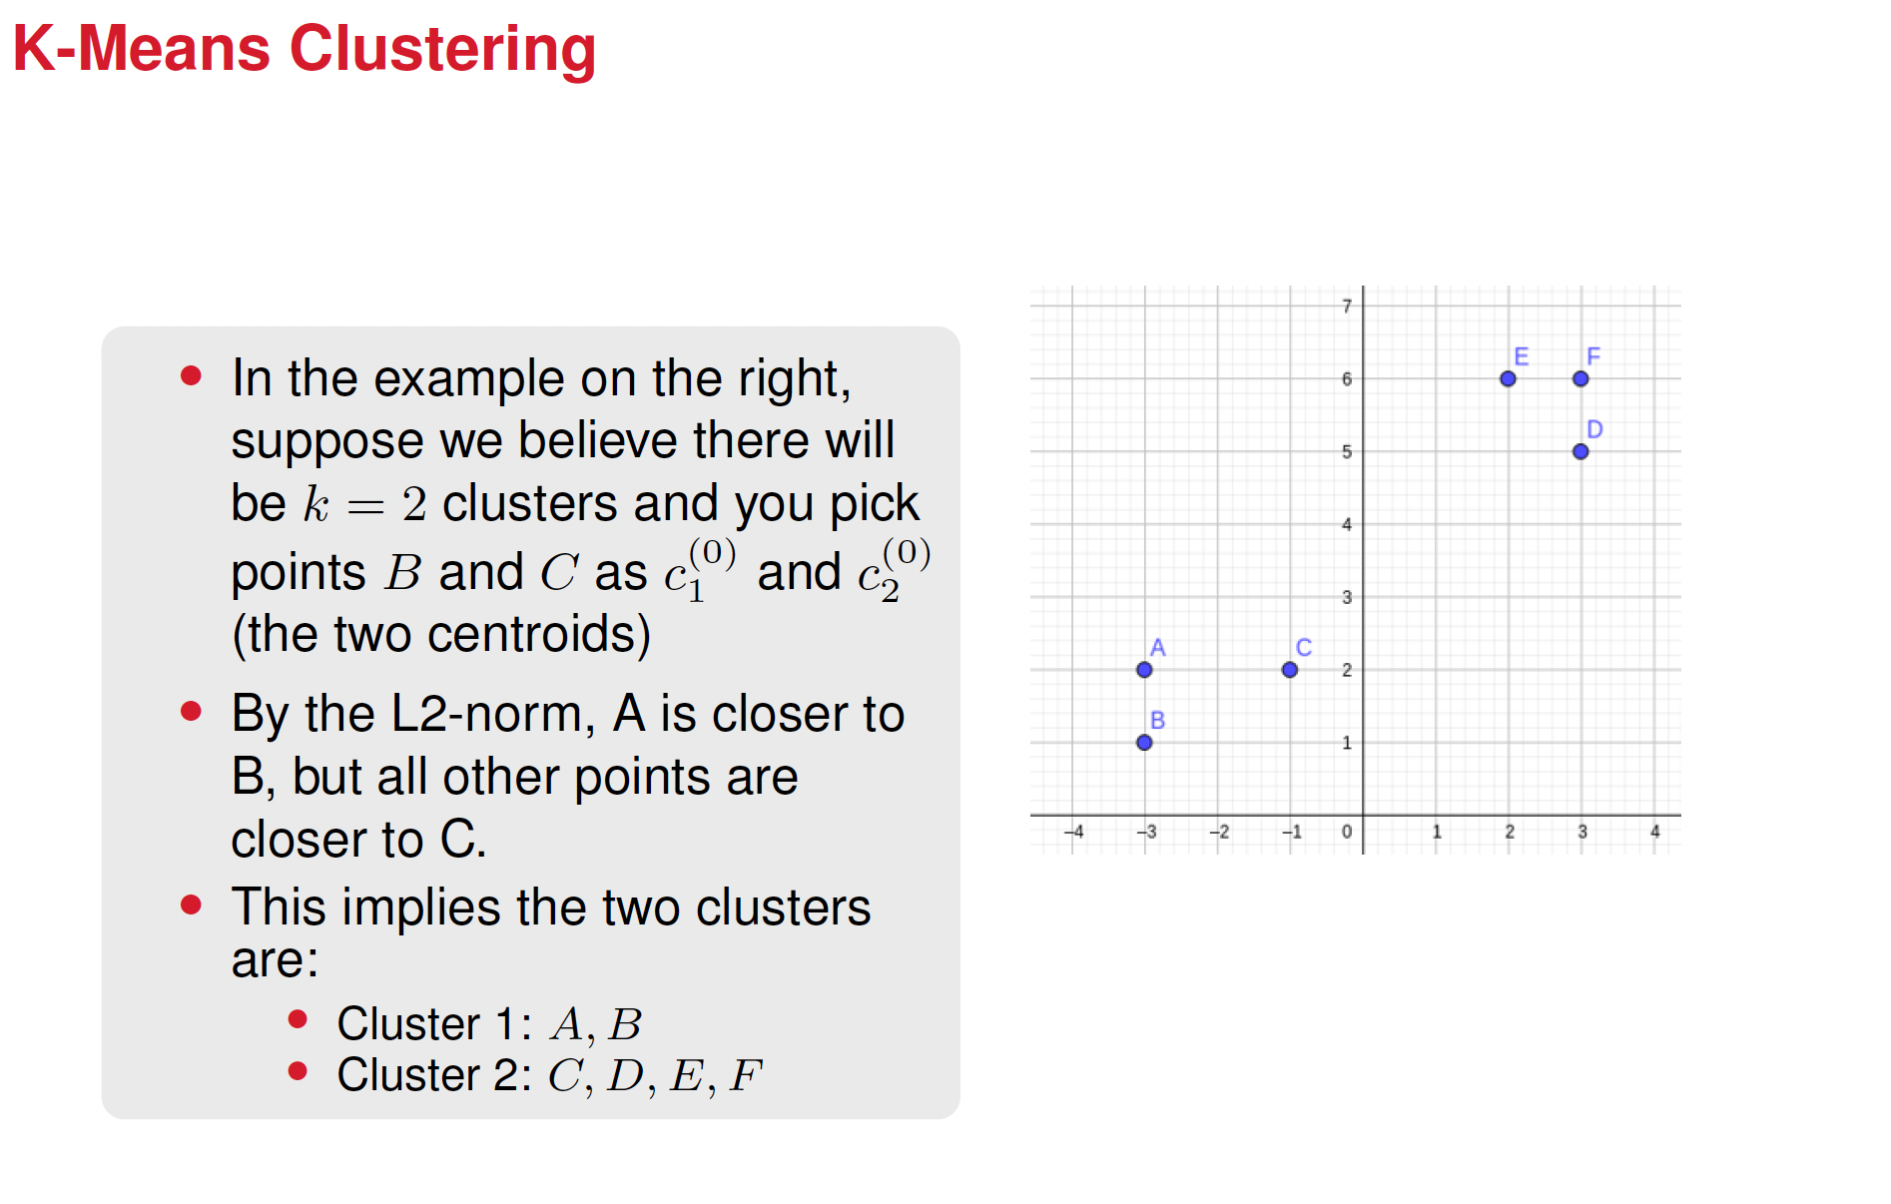

Slide 8
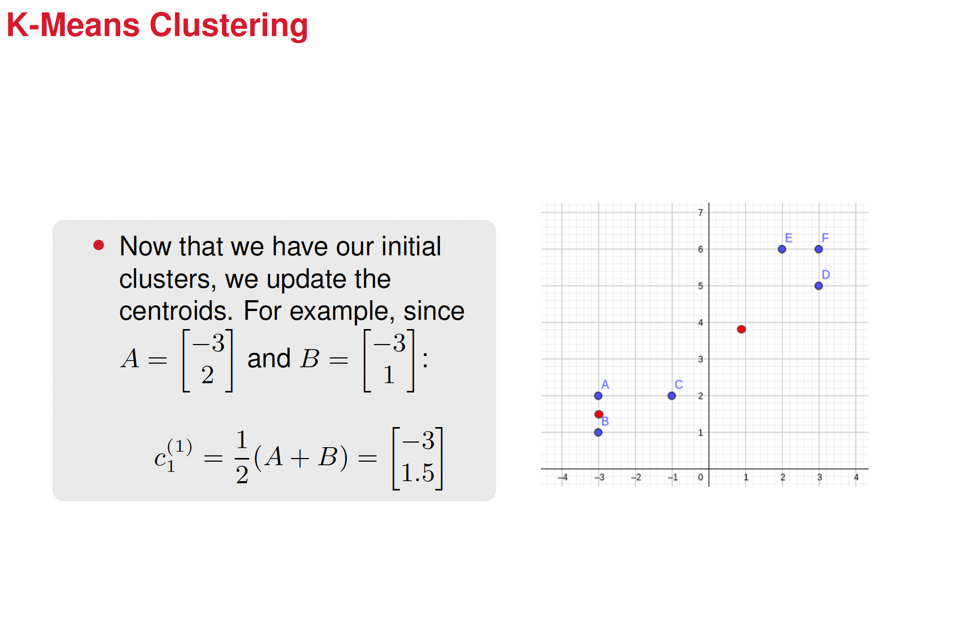

Slide 9
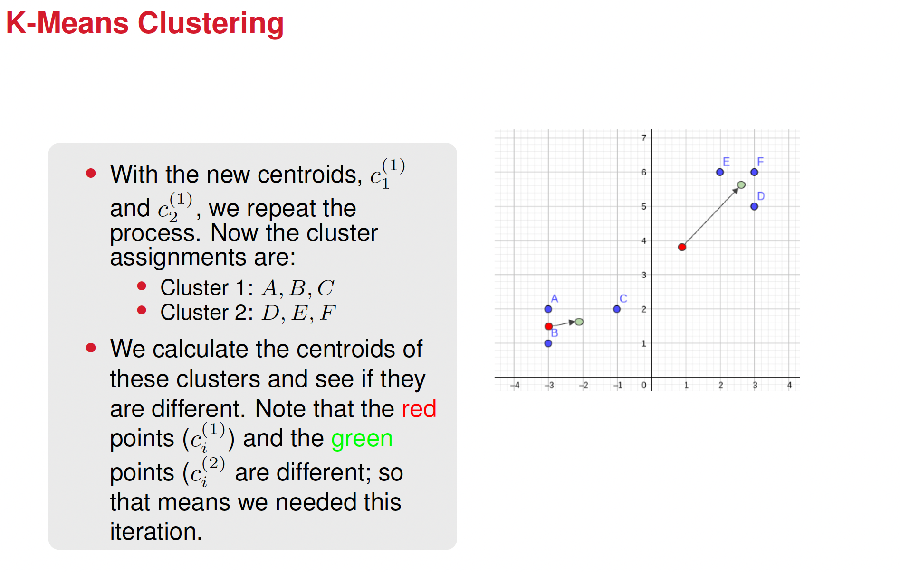

Slide 10
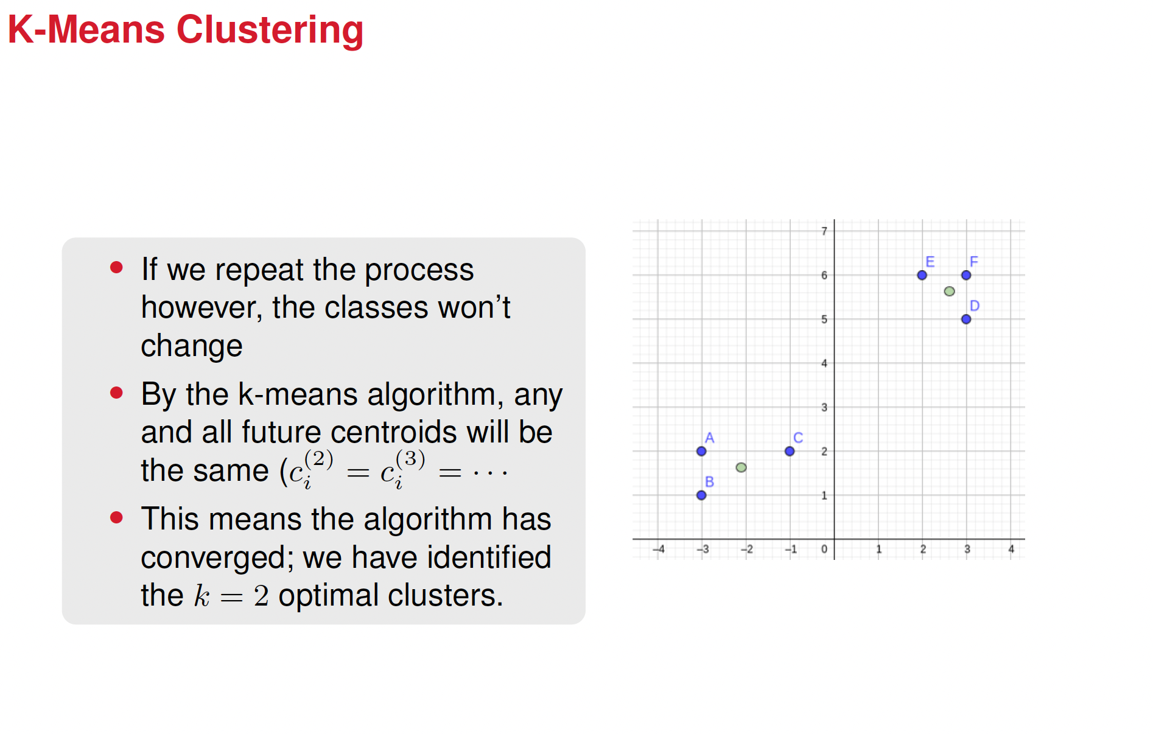

Slide 11
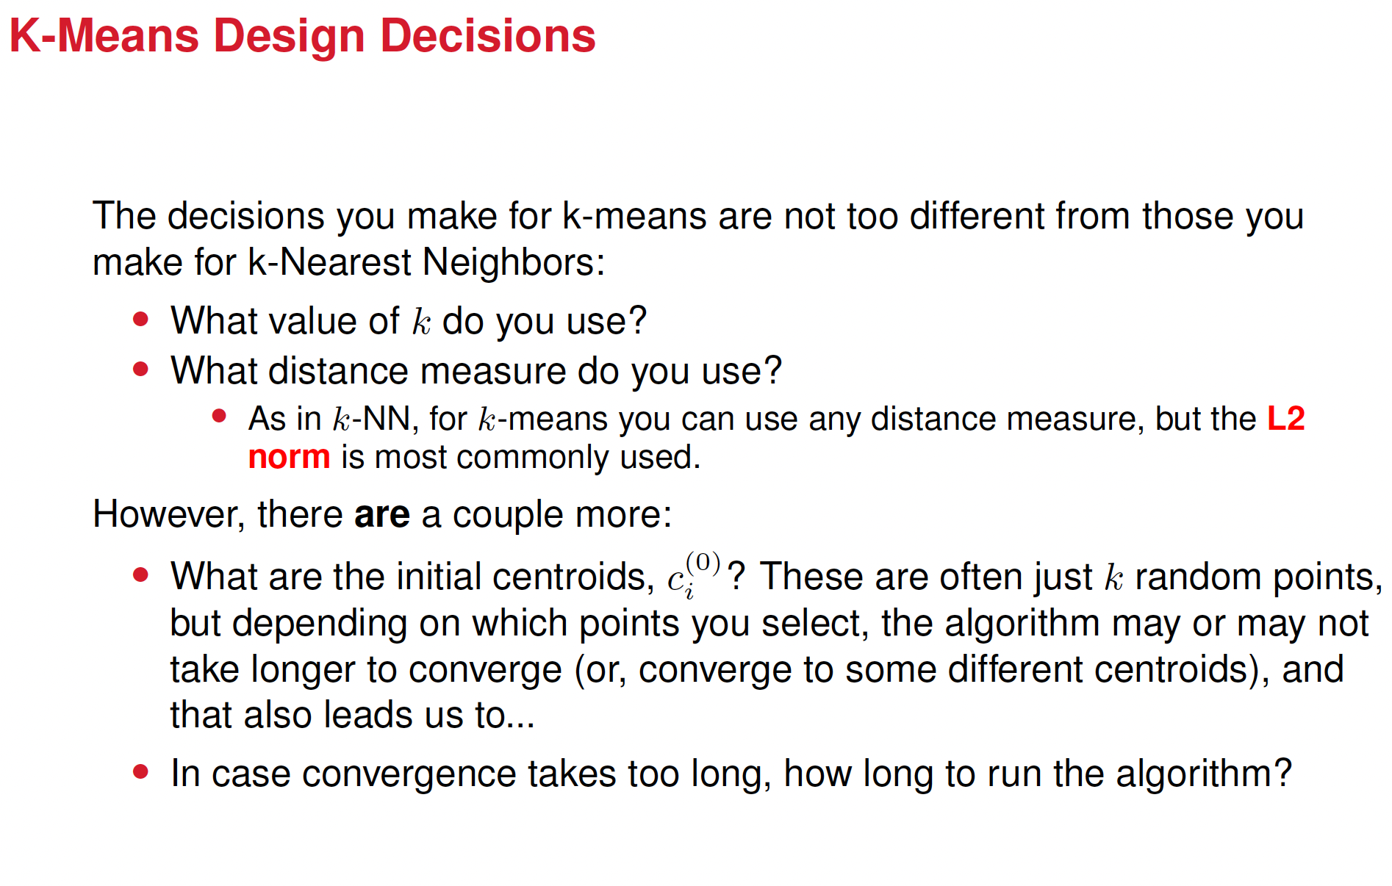

Slide 12
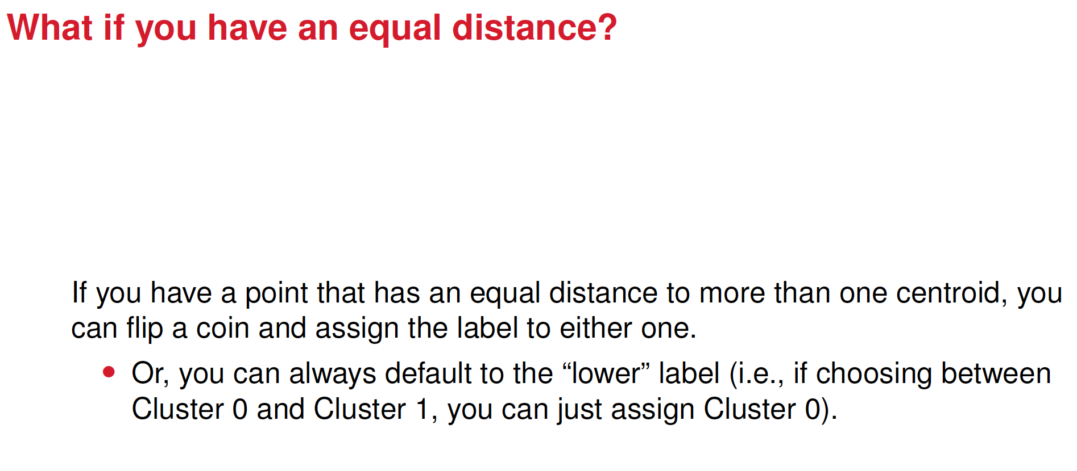

Slide 13
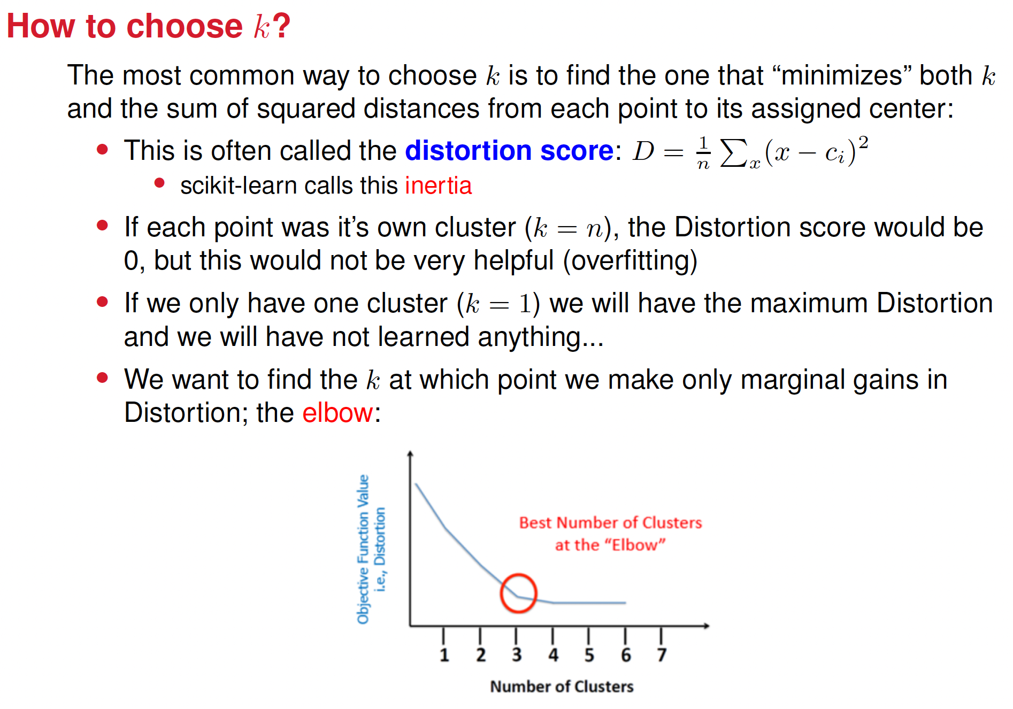
Distortion:
How tightly the data points are clustered around their assigned centroids?
Lower distortion = points are closer to their cluster center, which means tighter clusters

Slide 14
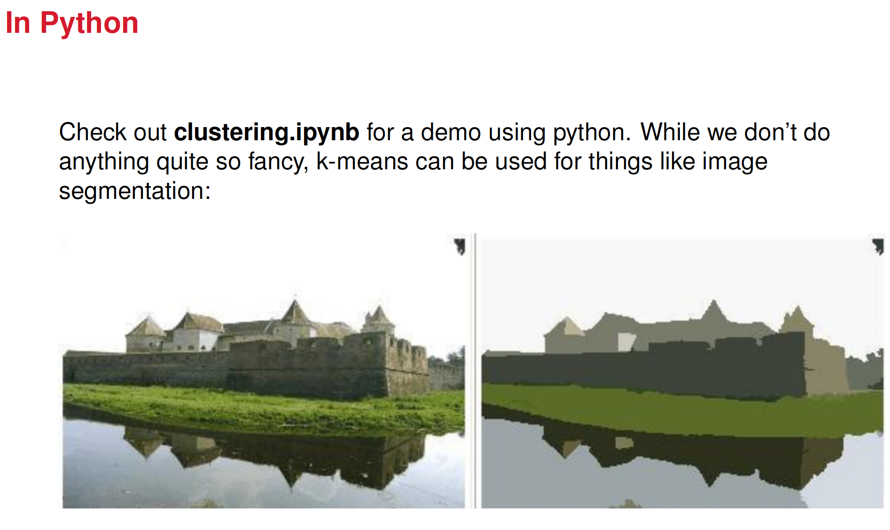
Treat every pixel as a point in color space (e.g. RGB) KMeans clusters similar-colored pixels, to which assigns labels and then forms segments (like background vs. object) etc.

Slide 15
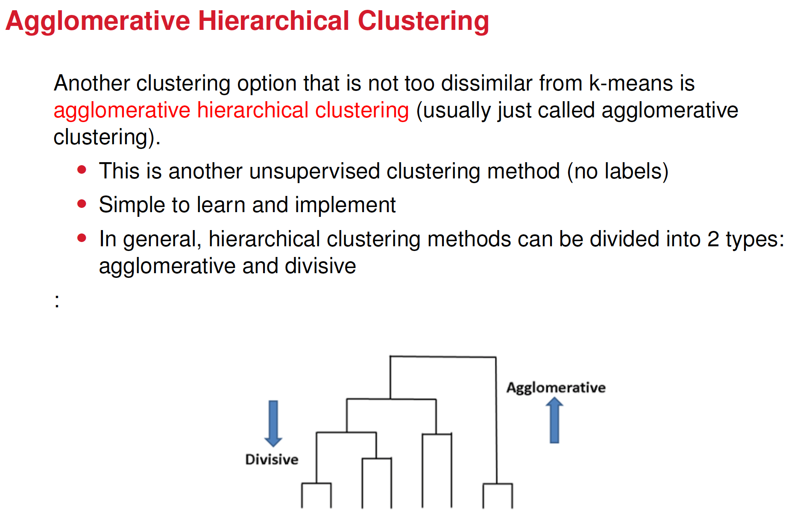

Slide 16
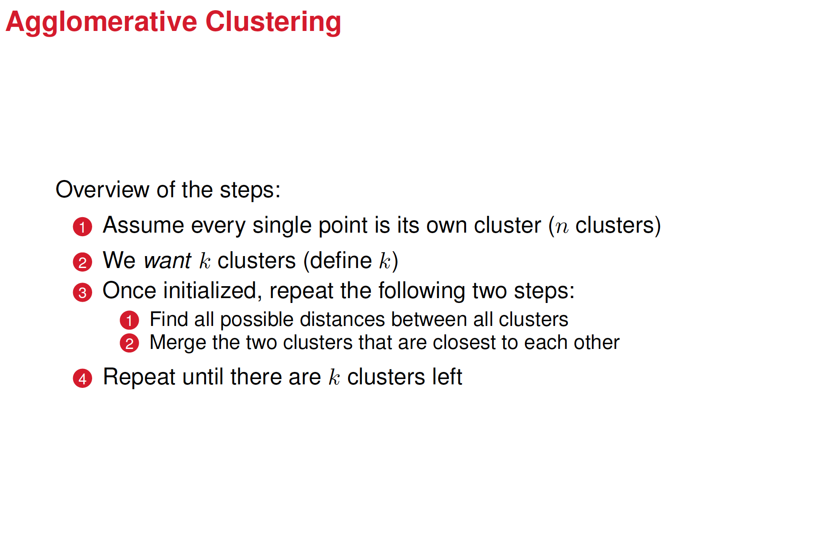

Slide 17
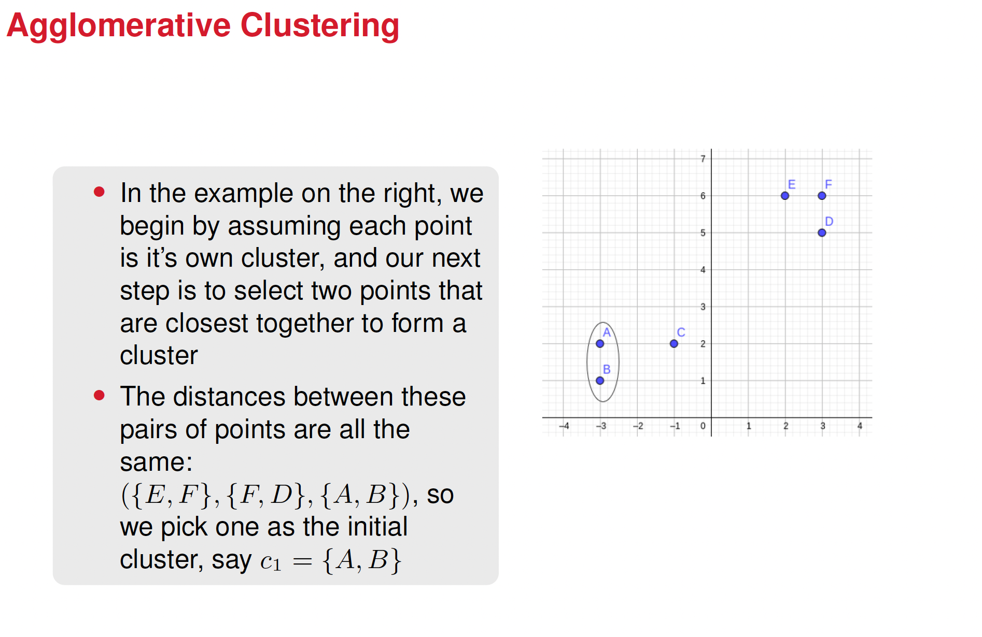

Slide 18
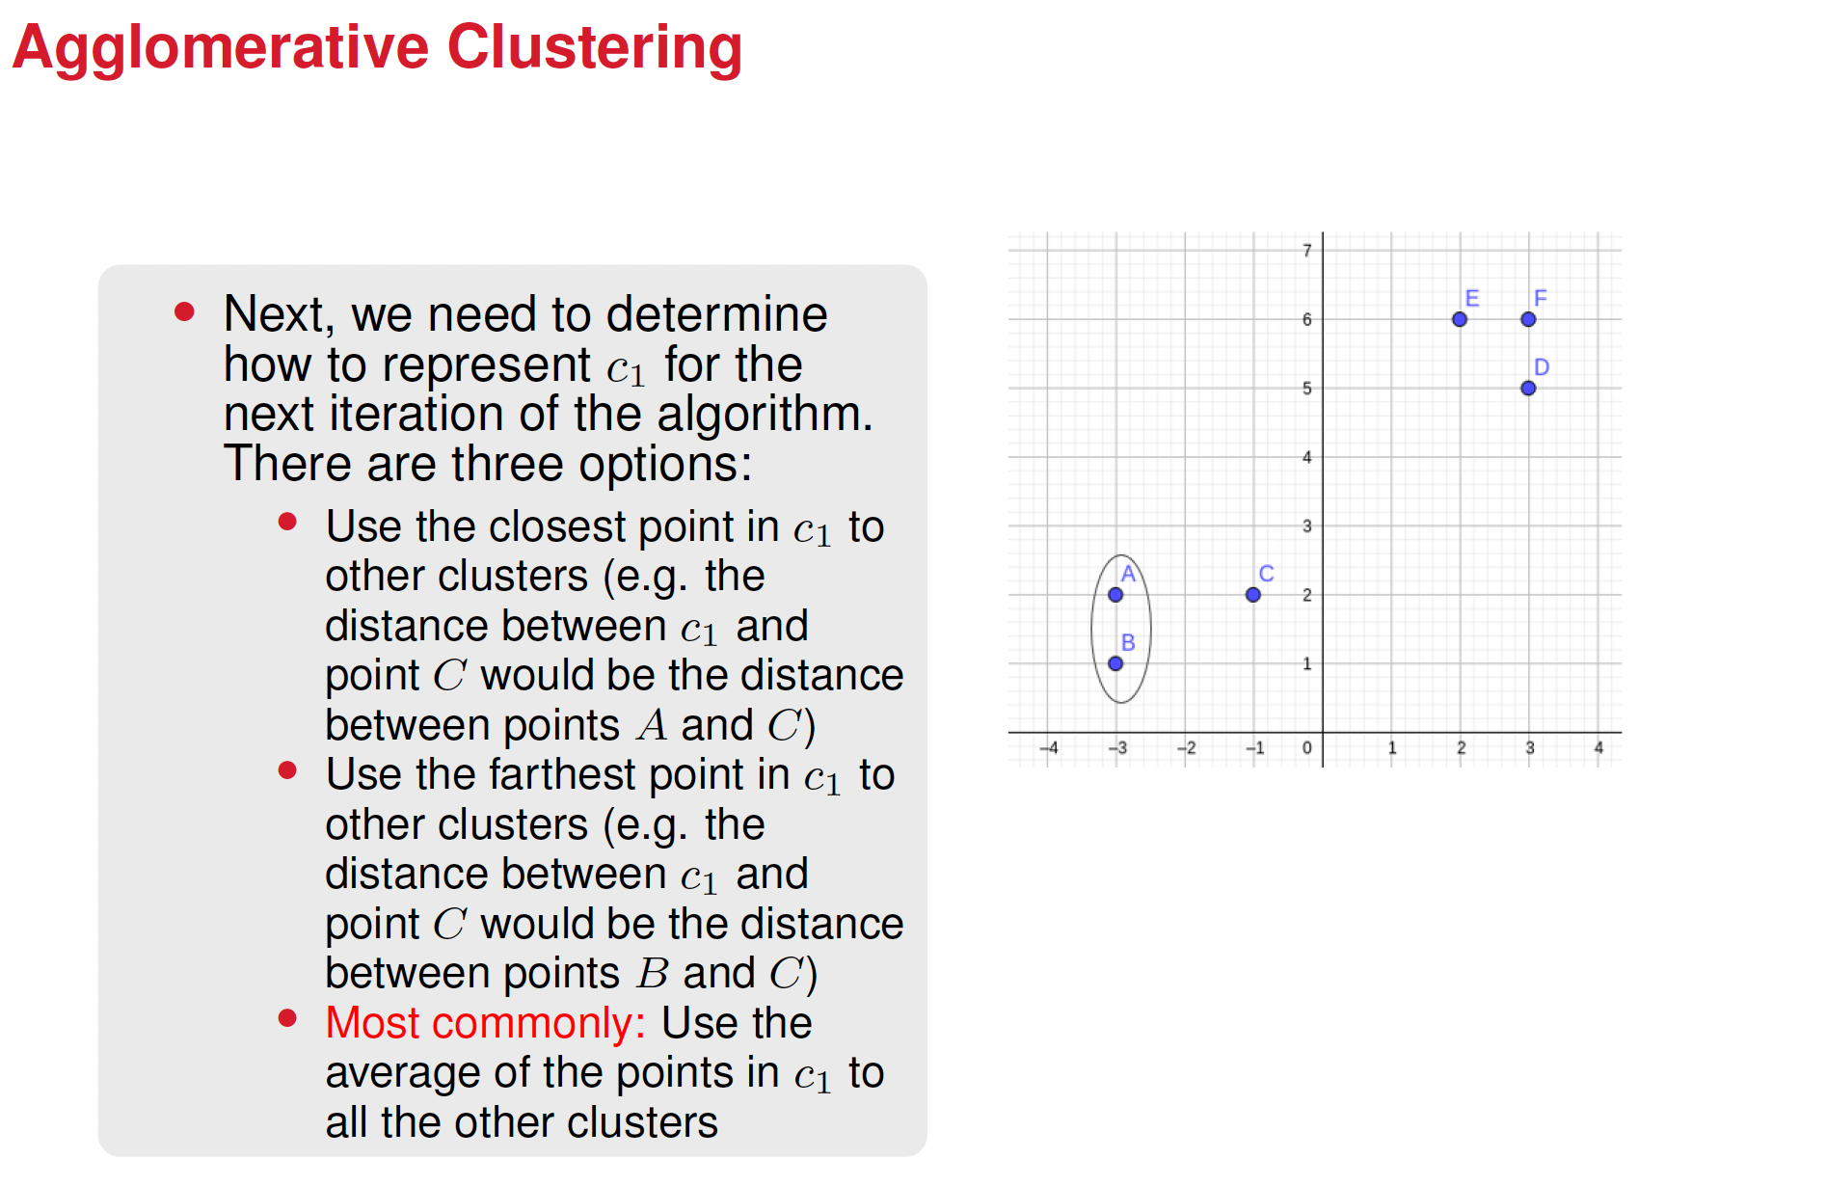

Slide 19
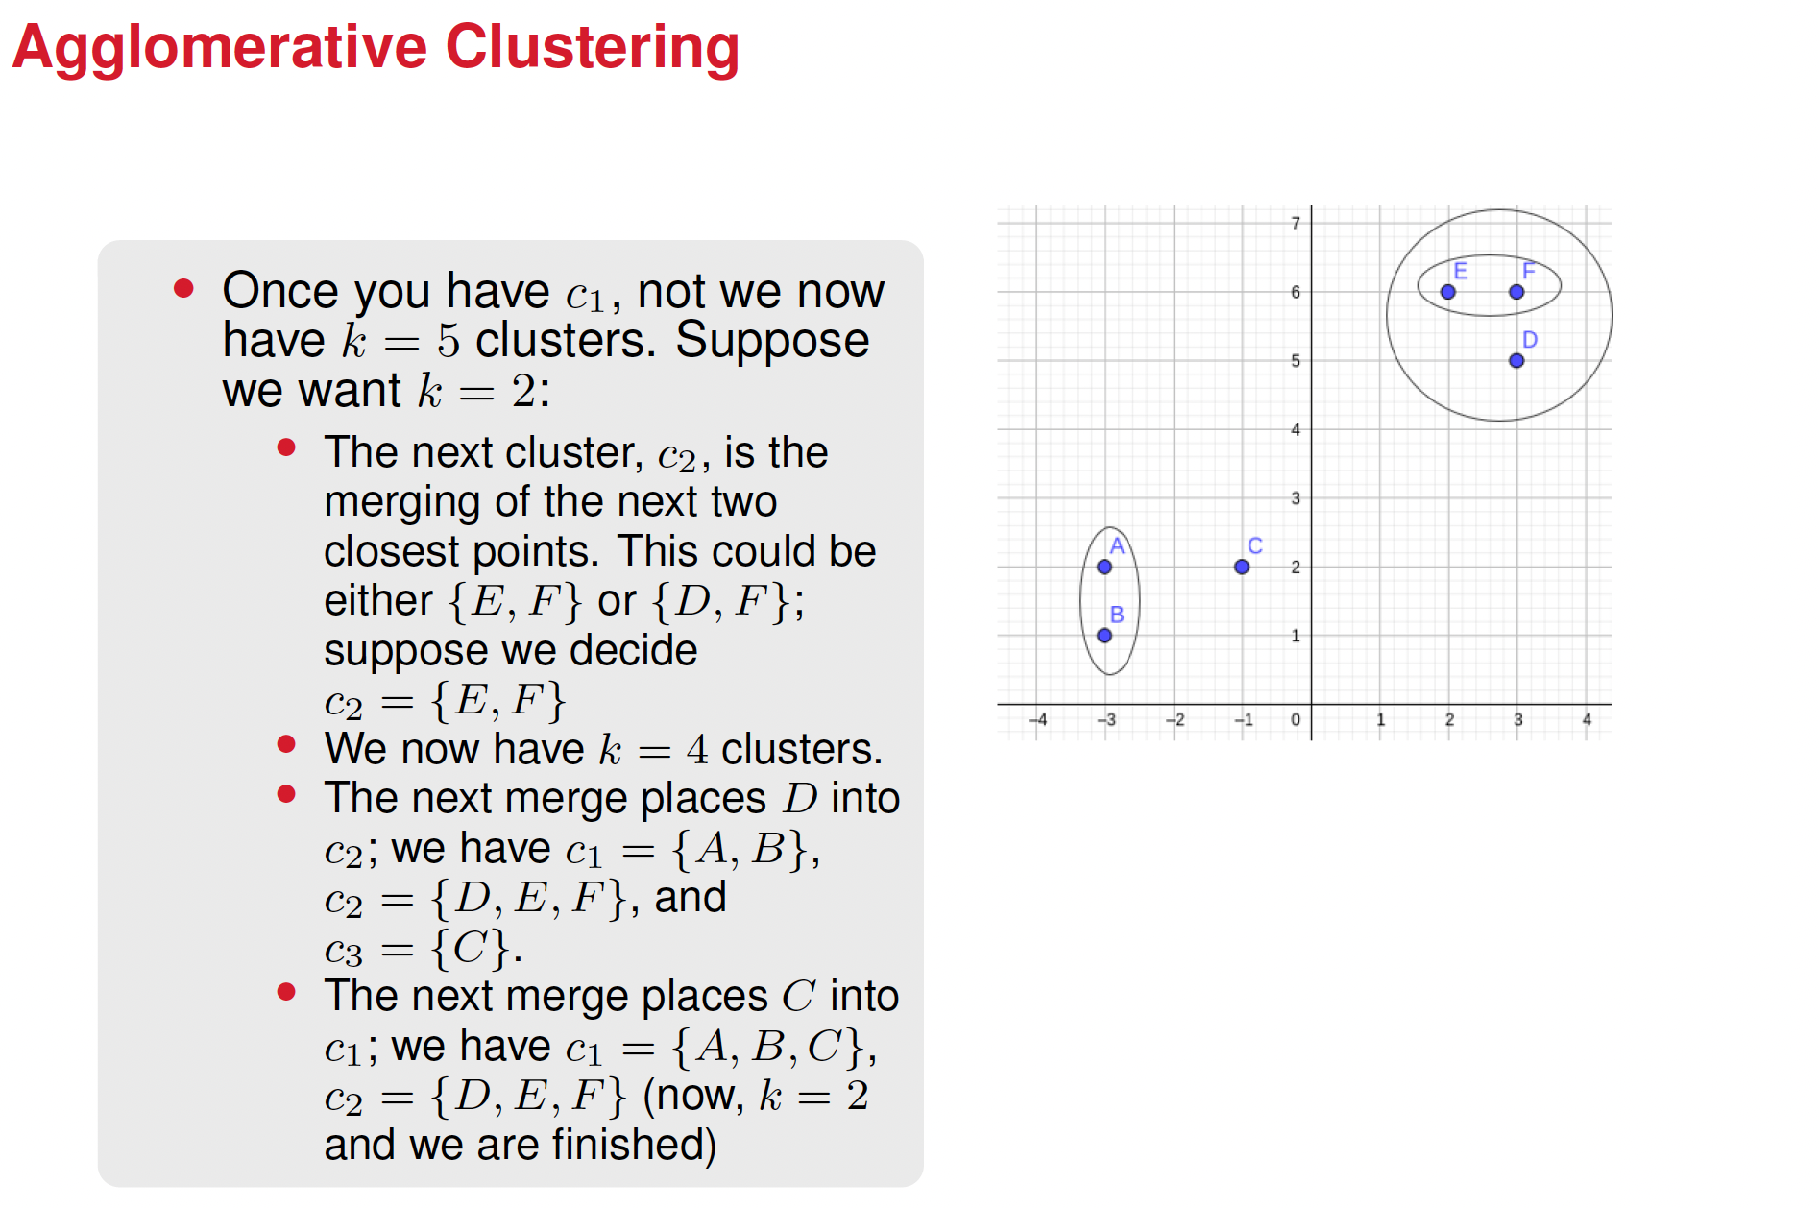

Slide 20
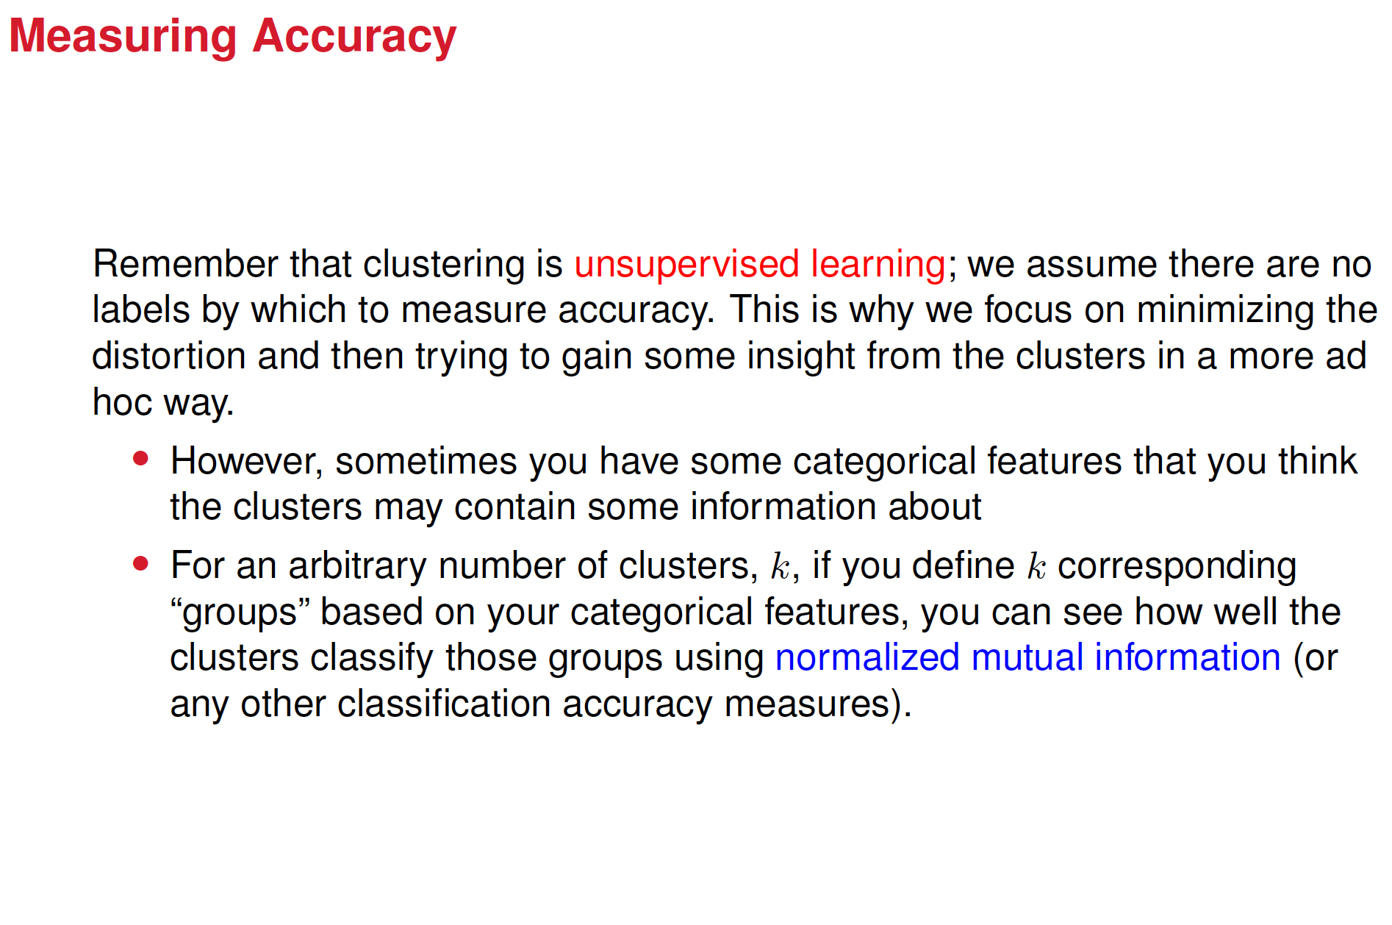

Slide 21

















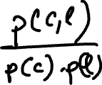


Mutual information for cluster classification

Slide 22
Interpretation of NMI in clustering
• NMI = 1 means perfect alignment between clusters and labels
• NMI = 0, no relationship between clusters and labels
• A larger NMI means a stronger clustering–label correspondence

Slide 23
